Slide 1
Advanced Topics in SWE
learn about the software reuse for web-based information systems and enterprise systems.
Introduce the different types of reuse that are possiblenand the most common approach to reuse
Learn how software reuse is applied to some components rather than entire software systems.
Learn the issues and problems of building distributed systems.
Introduce the client-server approach as a fundamental paradigm of distributed systems engineering
Introduces the concept services are reusable software components whose functionality can be accessed over the Internet (e.g., SOAP-based and RESTful services).

Slide 2
Software Reuse
Software Reuse is a software engineering strategy where the development process is geared to reusing existing software.
Until around 2000, systematic software reuse was uncommon, but it is now used extensively in the development of new business systems.

Slide 3
Types Software Reuse
System reuse Complete systems: made up of a number of application programs, may be reused as part of a system of systems
Application reuse: incorporating an application without change into other systems or by configuring the application for different customers. For instance, application families or software product lines that have a common architecture, but that are adapted to individual customer requirements, may be used to develop a new system.
Component reuse: ranging in size from subsystems to single objects. Components may be hosted on the cloud or on private servers and may be accessible through an application programming interface (API) as services.
Object and function reuse: Software components that implement a single function, such as a mathematical function, or an object class may be reused(e.g., java libraries

Slide 4
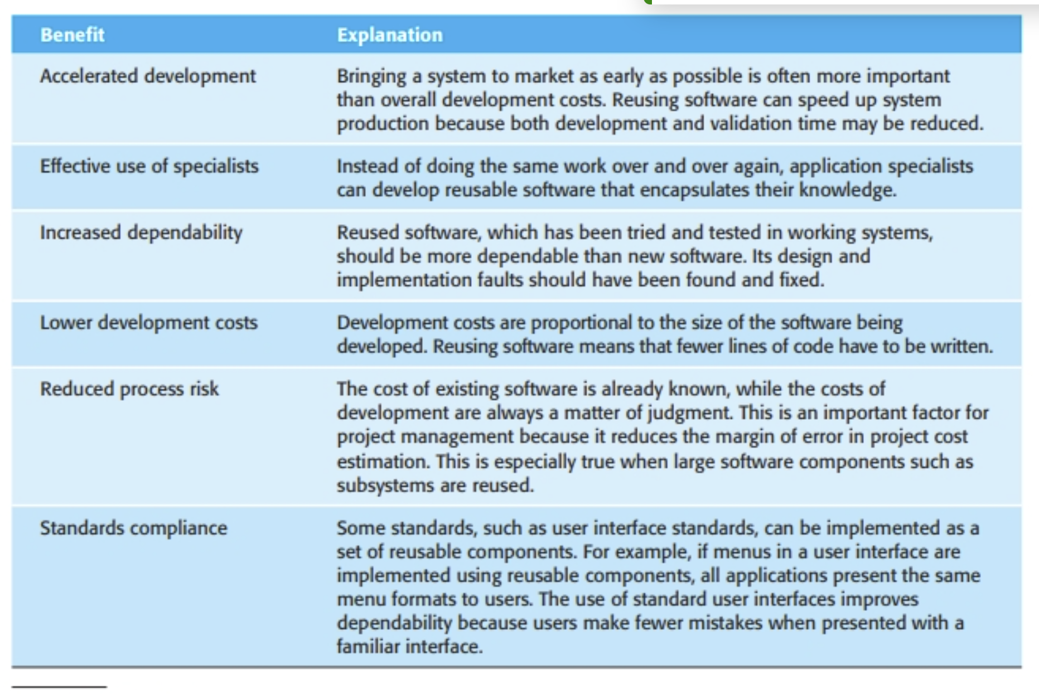
Benefits of Software Reuse

Slide 5
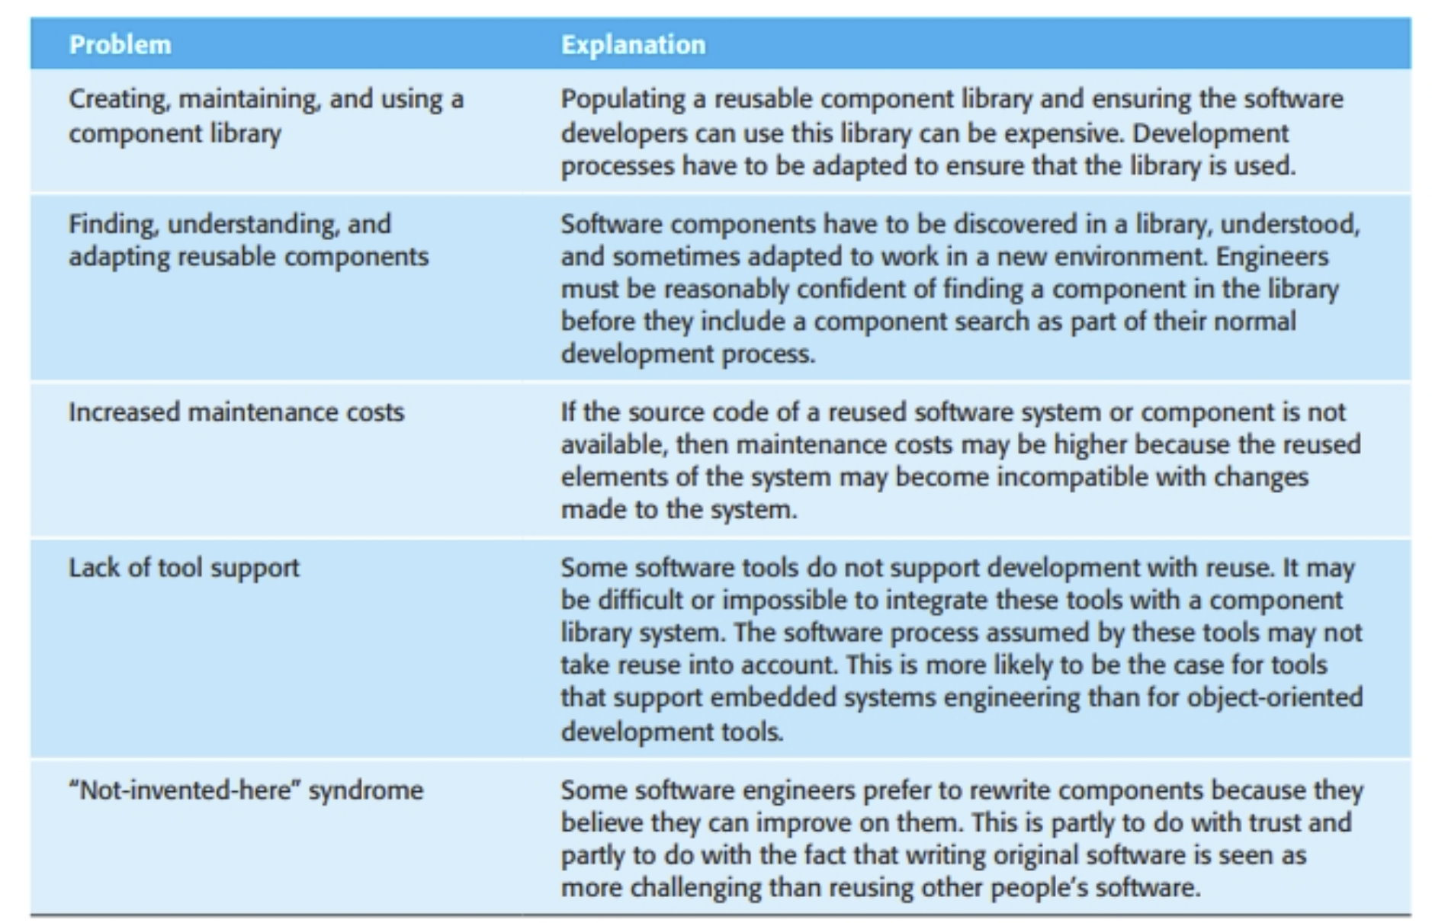
Problems of Software Reuse

Slide 6
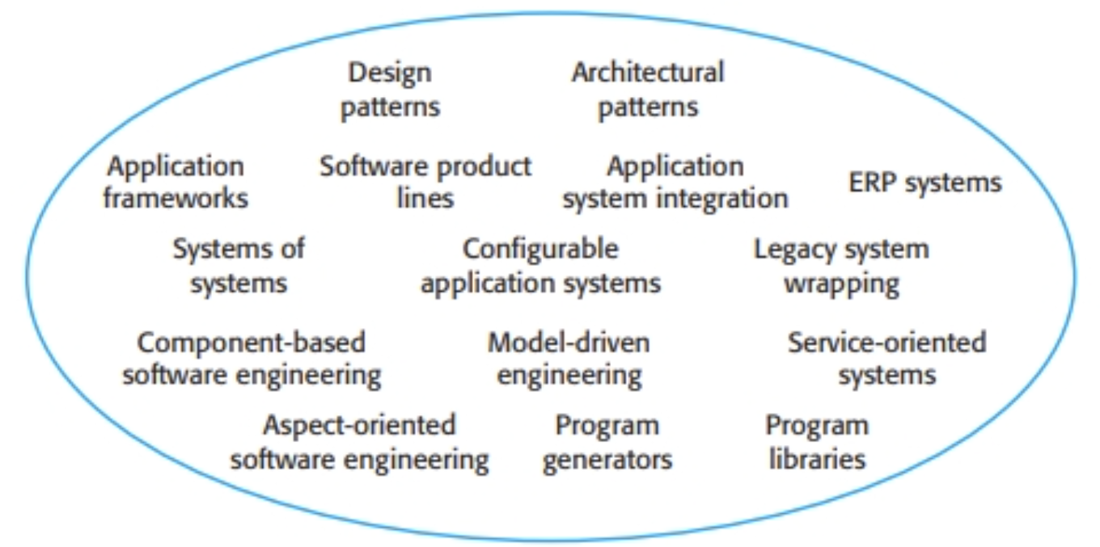
The landscape Software Reuse
Areas of Reuse
Which is the most appropriate technique to use in a particular situation?
Answer: it depends on the requirements for the system being developed, the technology and the reusable assets available, and the expertise of the development team.

Slide 7
Factors for Software Reuse
The development schedule for the software.
The expected software lifetime
Whether the system will be adapted to new requirements, which will mean making changes to parts of the system.
The background, skills and experience of the development
The criticality of the software and its non-functional requirements

